Slide 1

First Things First:
Letter of Intent, Emergency Plan
Session Nine
ADMH Webinar Series for Families

Slide 2
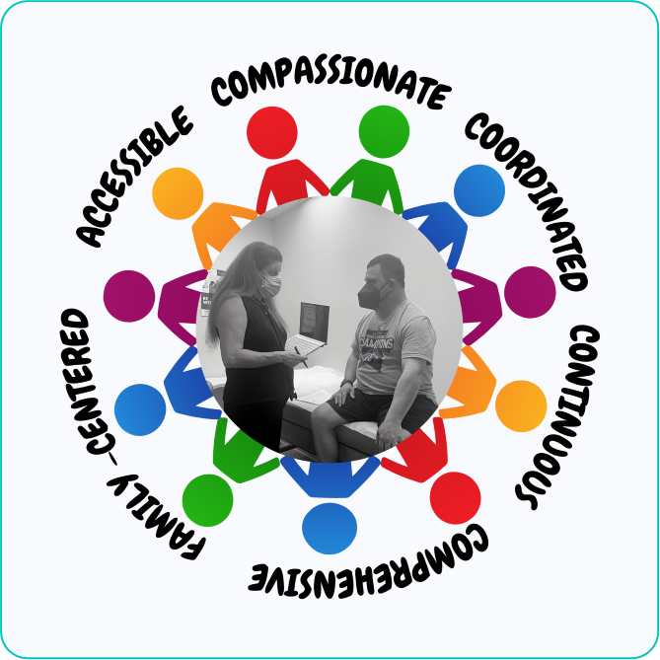
Wellness without Barriers
Our Mission:
ADMH provides comprehensive, coordinated, person-centered healthcare for teens and adults with developmental disabilities. We strive to empower individuals and their families to become advocates for their own health and wellness needs.
.

Slide 3
What is a Medical Home?
a model of primary care that is patient-centered, comprehensive, team-based, coordinated, accessible, and focused on quality and safety
a place where patients are treated with respect, dignity, and compassion, and enable strong and trusting relationships with providers and staff
a model for achieving primary care excellence so that care is received in the right place, at the right time, and in the manner that best suits a patient's needs
Notes:
Patient-centered: A partnership among practitioners, patients, and their families ensures that decisions respect patients’ wants, needs, and preferences, and that patients have the education and support they need to make decisions and participate in their own care.
Comprehensive: A team of care providers is wholly accountable for a patient’s physical and mental health care needs, including prevention and wellness, acute care, and chronic care.
Coordinated: Care is organized across all elements of the broader health care system, including specialty care, hospitals, home health care, community services and supports.
Accessible: Patients are able to access services with shorter waiting times, "after hours" care, 24/7 electronic or telephone access, and strong communication through health IT innovations.
Committed to quality and safety: Clinicians and staff enhance quality improvement to ensure that patients and families make informed decisions about their health.

Slide 4
Developing a Letter of Intent and Emergency Plan
Pat Satterfield
Dunamis Educational Foundation
www.dunamised.org

Slide 5
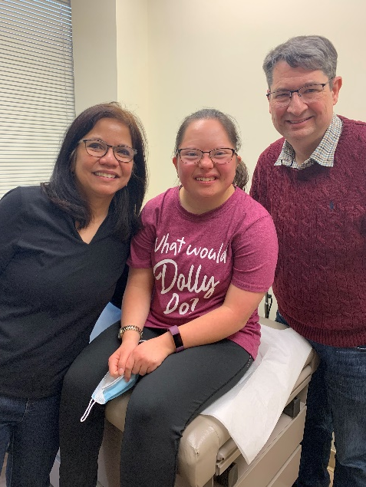
What is a Letter of Intent?
A Letter of Intent is a written description of your wishes for your child when you are away or no longer able to care for them. It has information on health, likes, dislikes, important people, etc.
This is important at any age and may
change over time as situations change,
health changes, and important people
may have life changes.
https://gatewayassociation.ca/family-support-for-children-with-
disabilities-fscd-what-is-it-and-how-you-get-it/

Slide 6

A Day in the Life
What would a great day look like for your son or daughter?
Where would he/she like to live? With whom?
What would an average day look like?
What would he/she need help with?
  Who would help?
Would he/she need more education?
What about employment/work?
What are favorite activities in the community?
What does he/she like to do for fun?
Would he/she like to be part of a faith community?
Notes:
You have been helping your child develop to their fullest potential for a long time. You know them better than anyone! What do you think your son or daughter’s best life looks like?? What things are most important to them? This may change over time and need to be updated as they get older.

Slide 7


What Information is in the
Letter of Intent?
Biographical Information
Family information for mother, father, grandparents
Any previous marriages
Medical History of Family Members
Siblings
  Contact information (updated)

Slide 8
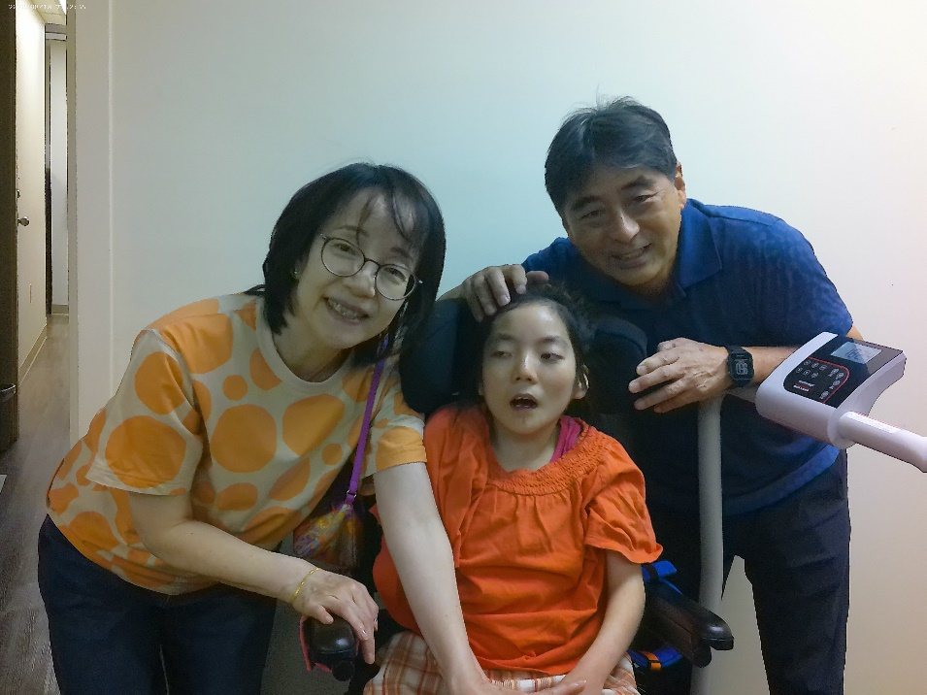
Your Child’s Medical History
Pregnancy and birth experience
  Where?
  Immediate issues
Diagnosis(es)
Genetic Testing
Chronic conditions
Surgeries and dates
Blood type and any Transfusions

Slide 9
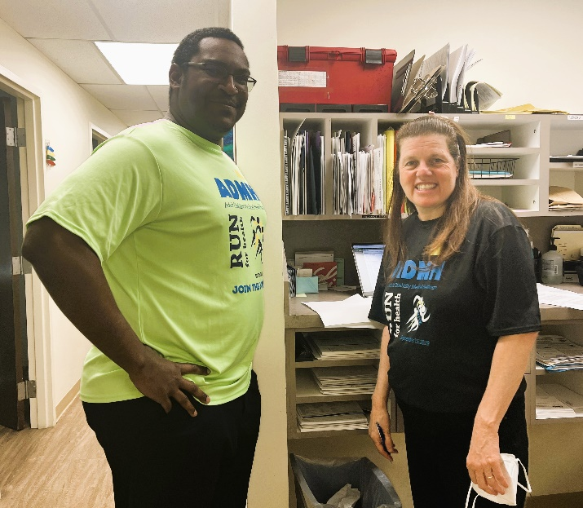
Medical Information
Previous and Current Doctors
  Medical Home or Primary Care Physician
  Specialists i.e. Neurologist, ENT, Psychologist
  Naturopaths or Chiropractors
Current Dentist
Medical Coverage*
Nursing Care Needs
*Do not include Medicaid number, health insurance ID, or SS information

Slide 10
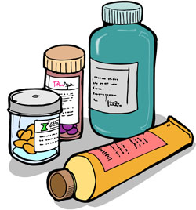
Current Medical Concerns
Emergency room visits
Seizures
  Procedures and aftercare
Medications/Dosages
  Need monitoring
Allergies
  Epi-pen?
Chronic conditions
Behavior Intervention
Mental Health concerns
Sitara Nayak from P2P
suggests that creating
a one sheet update
for your PCP.

Slide 11
Therapies – Past and Present
Physical Therapy
  Does the individual have typical mobility?
Speech
  Does the individual speak or do they use a communication system? Do they need language processing support?
Occupational Therapy
  Does the individual need help with fine motor tasks for daily living, school, or work?
Sensory Integration
  Does the individual need help in integrating the information that is coming into the brain from the senses?

Slide 12
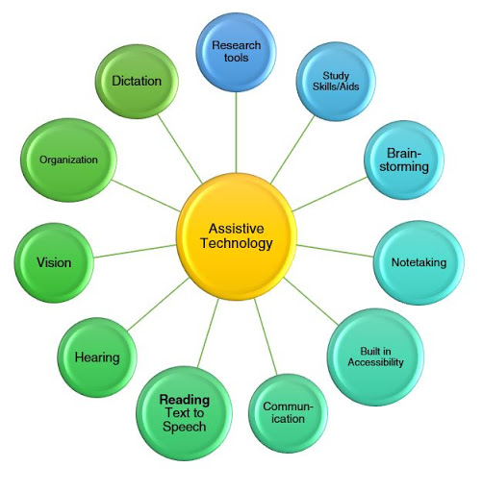
What Kinds of Assistive Technology?
Assistive technology is defined as “any item, piece of equipment or product system, whether acquired commercially off the shelf, modified, or customized, that is used to increase, maintain, or improve the functional capabilities of children with disabilities.”
IDEA 2004
Gpat.org

Slide 13


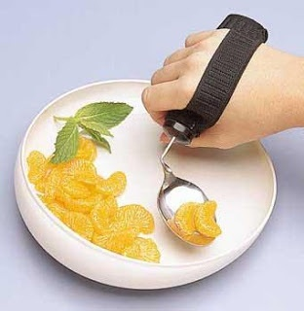
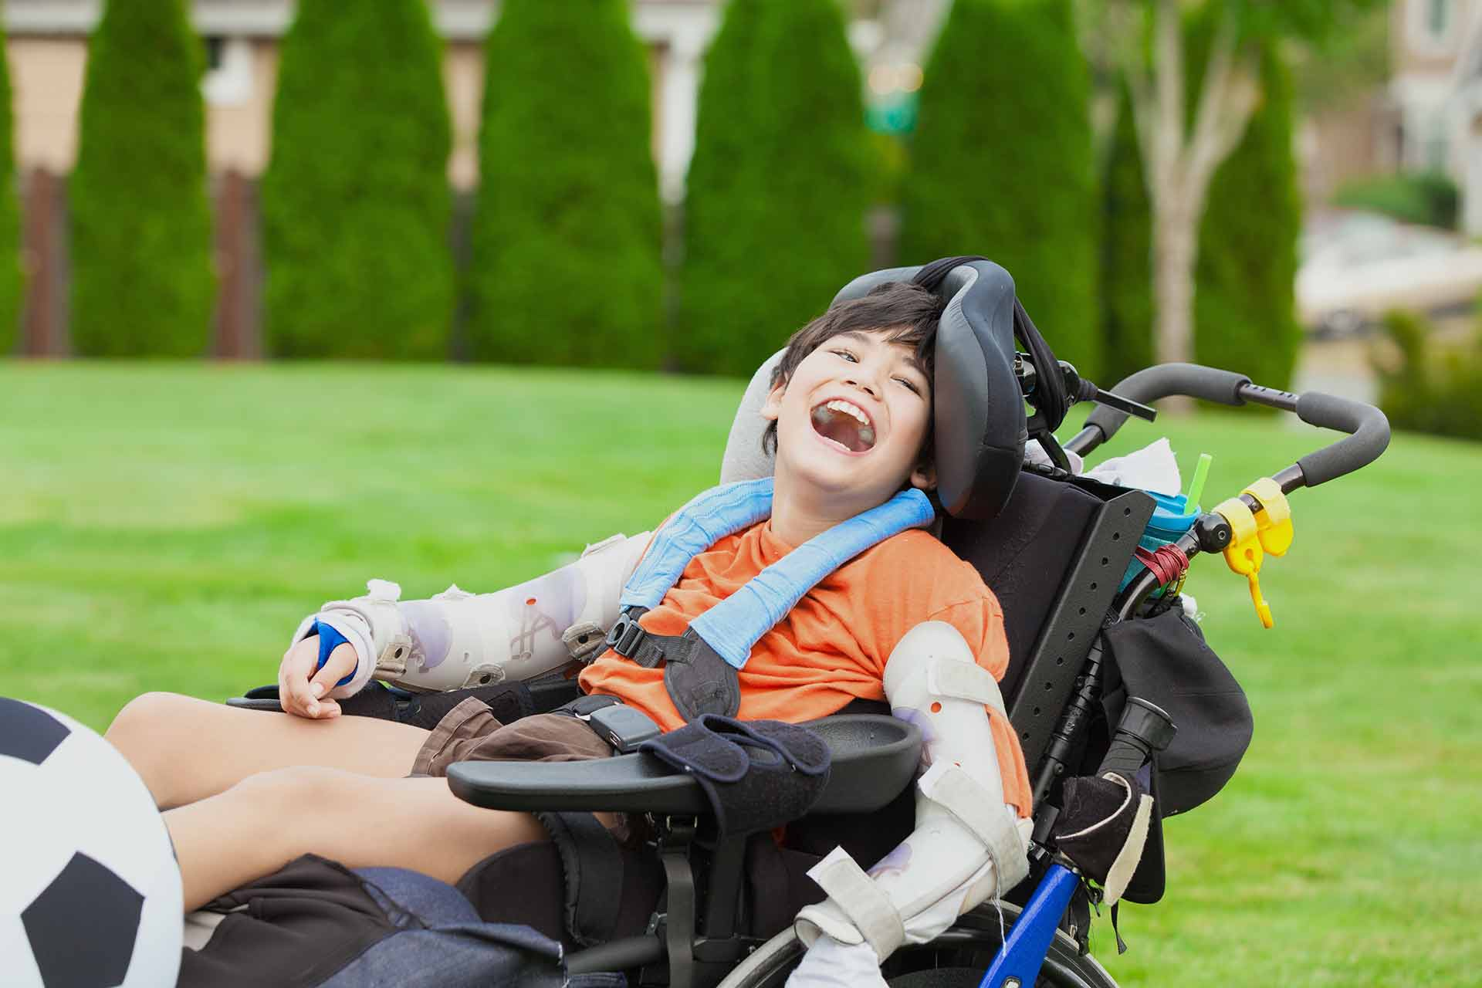
Daily Living Aids
Glasses
Hearing Aids
  Support for adjustments
Mobility aids
  Wheelchair, walker
  Shower chair
  Lift
  Special dishes or eating utensils
Pinterest
Penfield Building Blocks

Slide 14
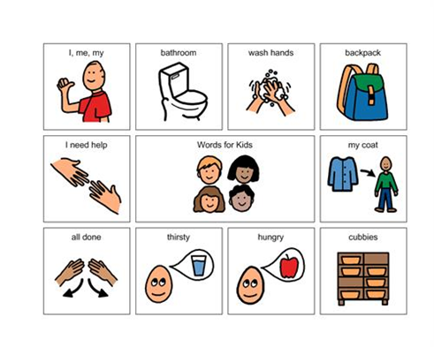
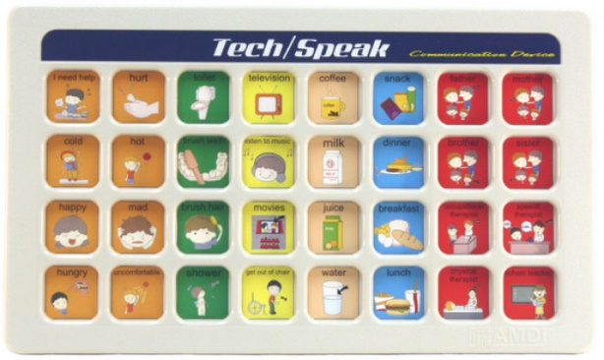
Communication Aids
No or low-tech solutions
  Pictures or symbols in a notebook
Mid tech solutions
  Battery operated solutions
High Tech solutions
  iPad, tablet, or dedicated communication device

Slide 15

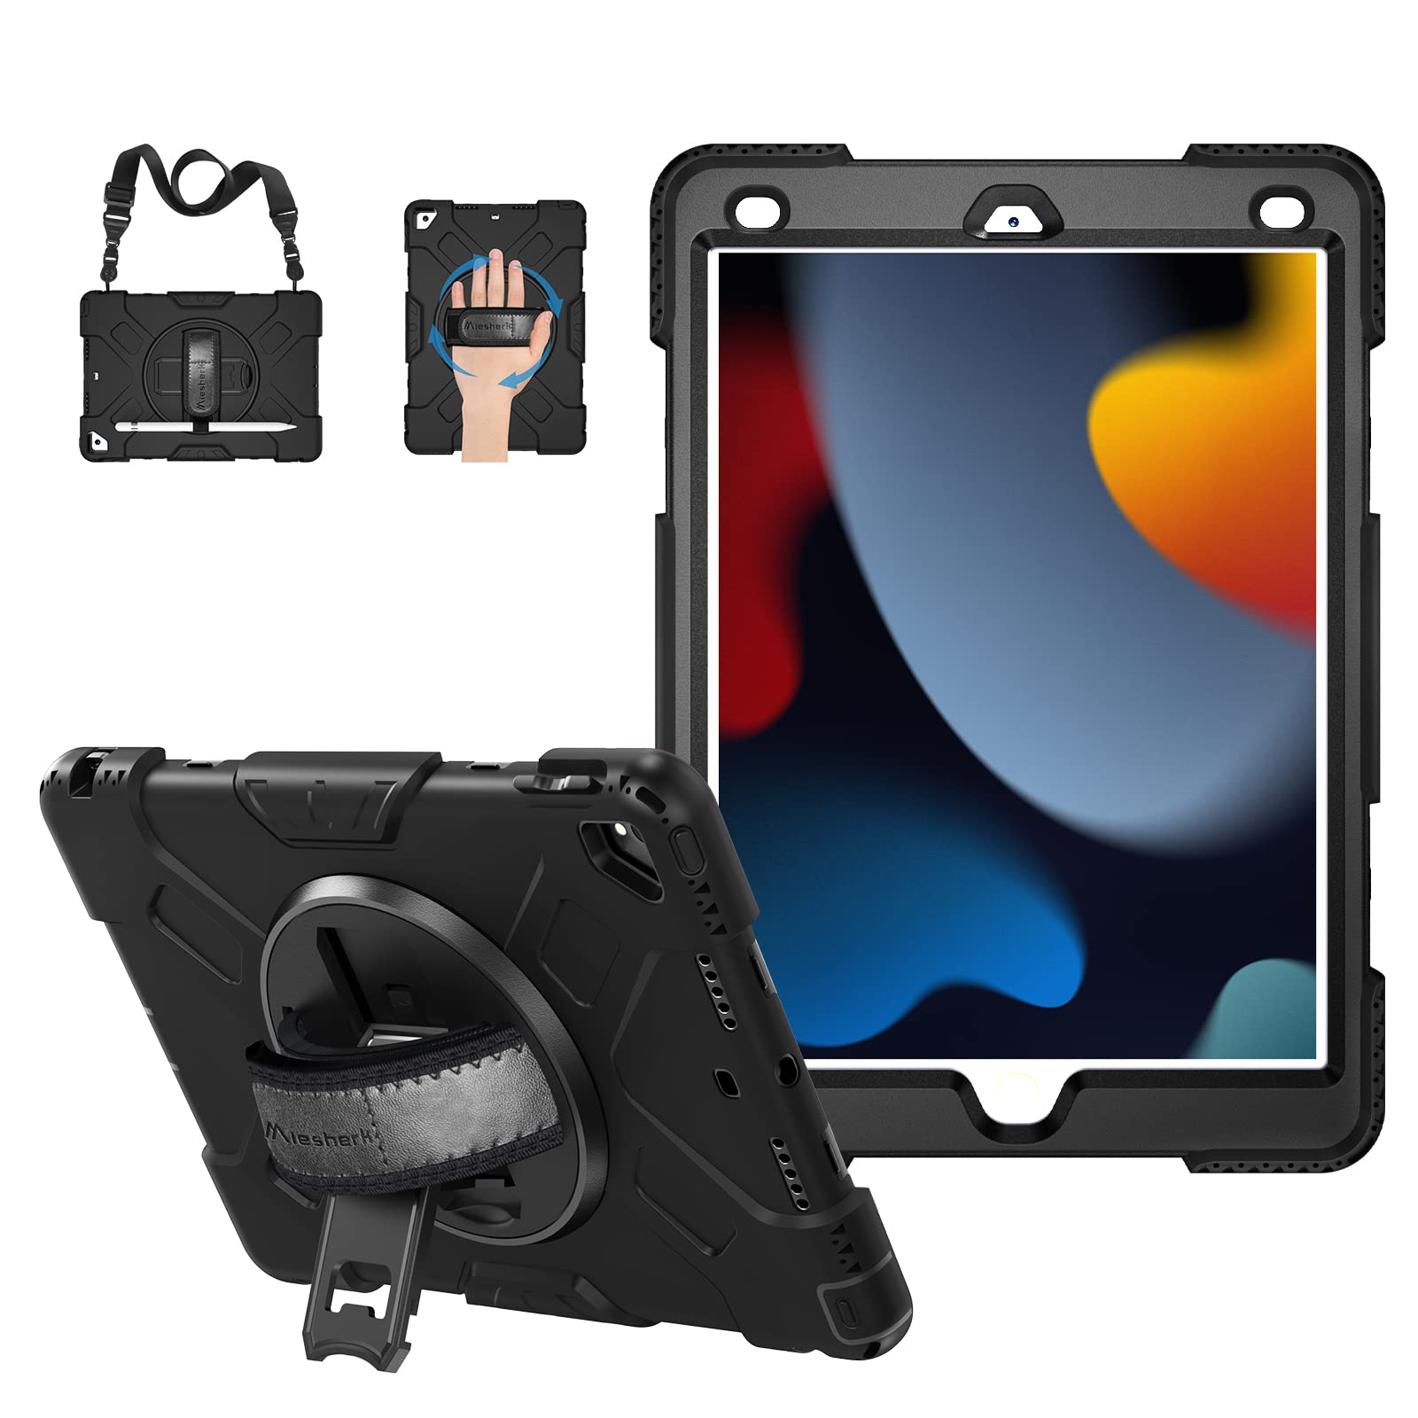
Phone, Devices, and Passwords
Does your loved one have their own phone?
Ipad?
Computer?
What are the passwords*
Is there a special purpose for the device (i.e. communication)?
What apps are important to him or her?
Do they need protective cases?
AARP
Amazon

Slide 16
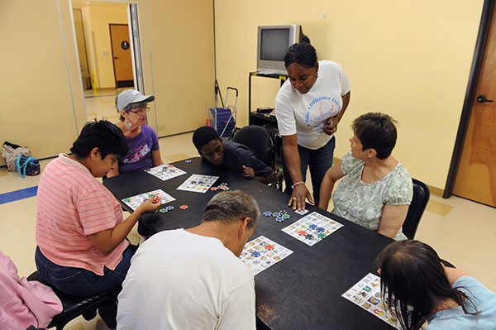
Community based Program
What program do they attend?
What days of the week?
Contact information
Transportation to the program?
Do they take lunch?
St. Madeleine Sophie’s Center

Slide 17
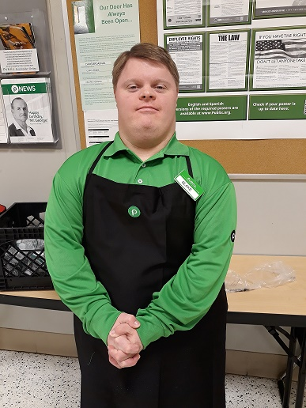
Work Information
Where are they employed?
Contact person at work
Where is their schedule found?
Appropriate dress for work
Do they take lunch or buy it?
Transportation to work?
If they volunteer, that information should also be included.

Slide 18


Favorite Items or Activities
A favorite toy? Blanket?
A favorite activity?
A favorite place to sit or hide?
Favorite music or videos?
Favorite foods?

Slide 19
Diet Exercise
Typical diet or a modified diet?
Food sensitivities or allergies?
Kinds of foods not well tolerated?
Foods to avoid due to medication?
Weight concerns?
Constipation?
Problems with exercise?
Favorite kinds of exercise?
Things to watch for while exercising?
Workout buddy?
Special Olympics or Special Pops tennis?
Other activities like karate or pickleball?

Slide 20
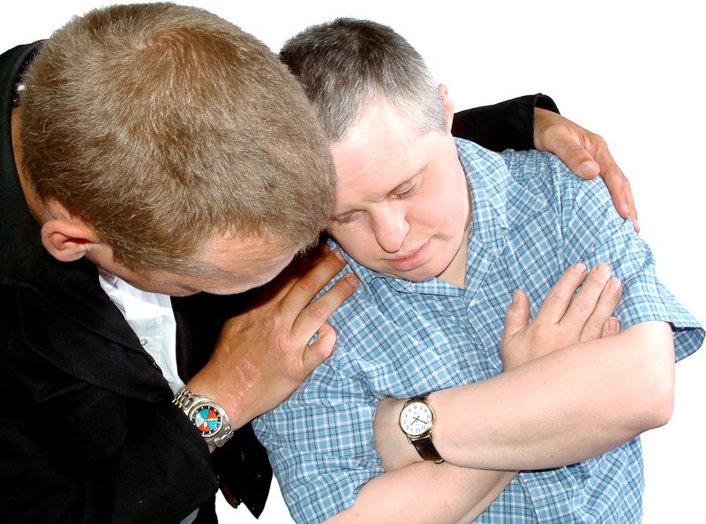
Special Problem Areas
Social Interaction
Language Processing
Negative reactions to temperature or noise
Upsetting things
Tendencies to “get stuck” doing something or thinking about something
Notes:
These things are as varied as each individual is unique.

Slide 21

Legal Plans
Primary and Secondary Guardians
Wills and Special Needs Trusts
Advocates
Supported Planning Group
Power of Attorney
Advisors and Lawyer
Representative Payee
Final Arrangements
Special Needs Database https://www.p2pga.org/the-special-needs-database/

Slide 22
Financial Concerns*
The Individual
The Family
Does she receive SSI and/or SSDI?
Is she working?
Can she handle regular banking activities?
  Deposits
  Withdrawls
  Balancing
Can she use a debit card responsibly?
Can she use cash correctly?
Do you have a will?
Do you have a third party Special Needs Trust? (There is more than one kind)
Does the individual have an ABLE account? How do the trust and ABLE account interact? What happens to that money when the person passes?

Slide 23

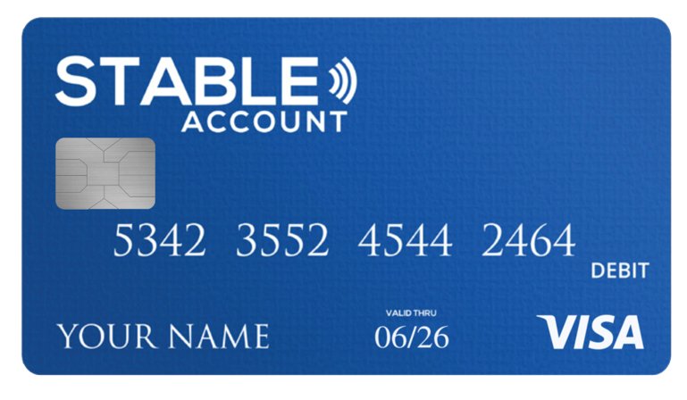
Who will Help with the Finances?
What funding sources do they have?
Who is the contact for each funding source?
Do you have a financial advisor?
Who will be representative payee?
Who will manage transferring funds from the trust or ABLE account?
Who will report on earnings if they are working?

Slide 24

Two Notebooks?
One for caregivers that are short term – what do they need for everyday living?
One for long term care – with medical and financial information, passwords to medical and financial accounts, important documents. Keep in a safe place with your legal documents.

Slide 25
Medical Emergency Plan
Everyone needs a medical emergency plan. This is the most personal and critical plan one can have.
The plan should be simple and be able to be understood at a glance.
Plans need to be kept in many places - at home, at school or community-based program, and on the individual (i.e. phone).

Slide 26
Medical Emergency Plan
Each person should have vital medical information and personal contacts in a document on your phone and their phone. Do not include Social Security information or insurance information, in case the phone is lost.
Name
Diagnosis(es)
Medications
Blood type, allergies
Emergency contact(s)

Slide 27
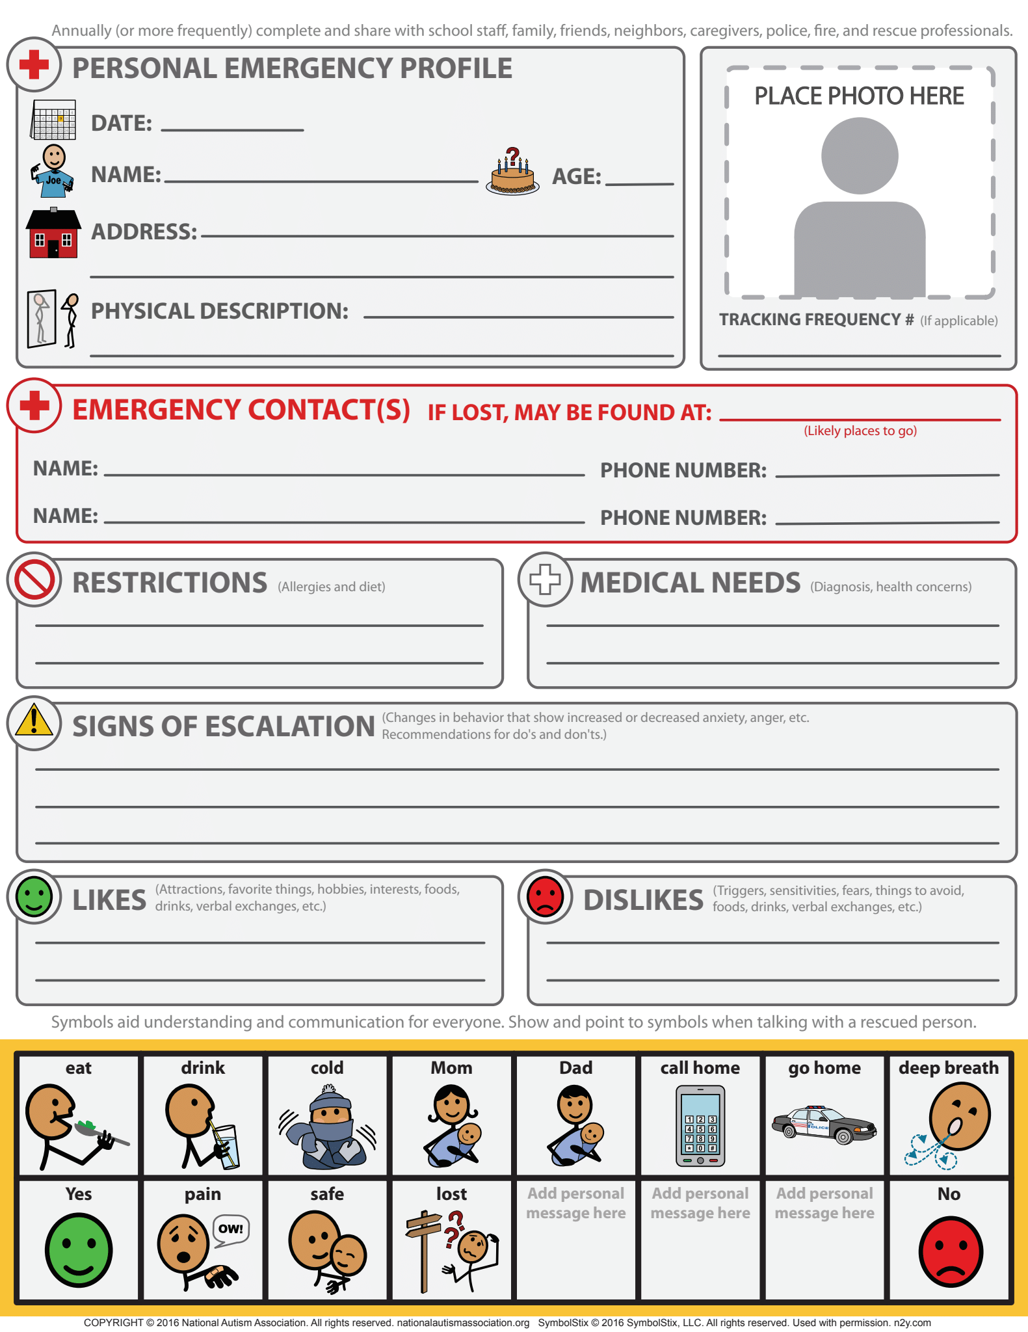
Include:
Personal information with a photo
Who will support you while your emergency contact is notified?
Where you would go in case of an emergency that requires evacuation?
Medical conditions and medications
Blood type
Allergies
Behavioral supports if needed.
Communication component

Slide 28
Emergency Plan for the Individual
More than one way to carry an emergency plan with me.
Wallet – a single sheet of paper with the most critical information
Cell Phone – a picture of the Emergency plan; a list of contacts: Emergency contact, parent, sibling, 911
FEMA

Slide 29
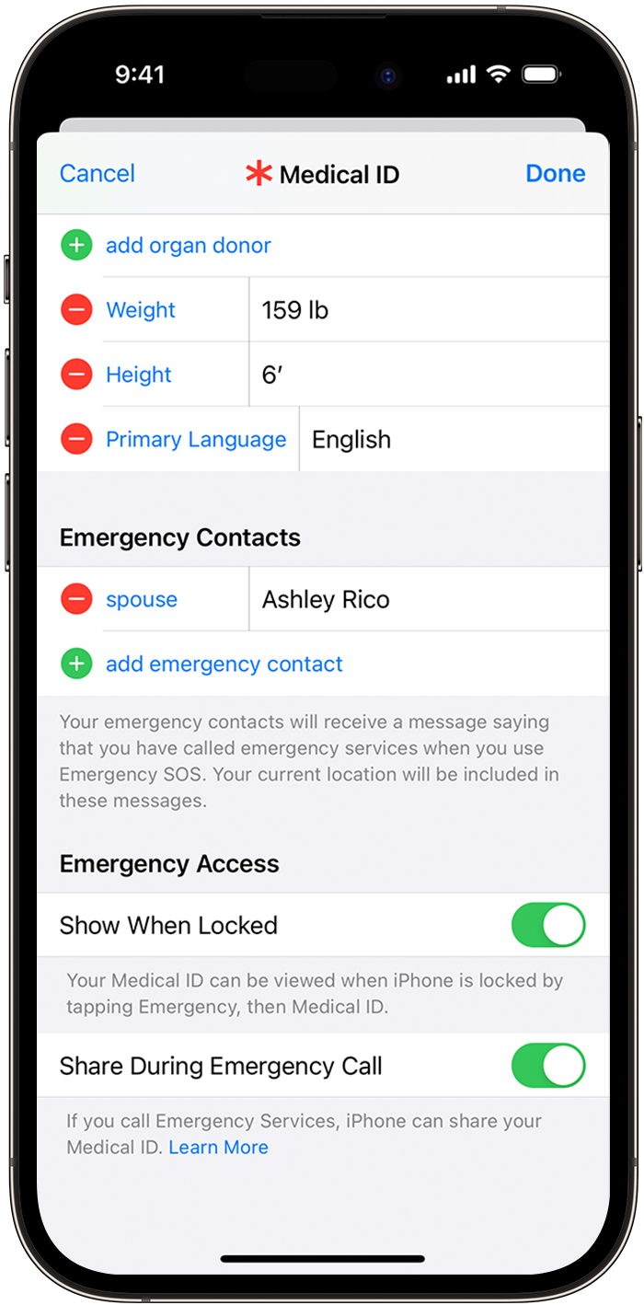
Adding the Plan to their iPhone
Health app
Create Medical ID
Turn “Show When Locked” on
Enter demographics–include a photo (use the phone to take a selfie)
Enter Medications/Allergies/Medical notes
Add Emergency Contacts

Slide 30
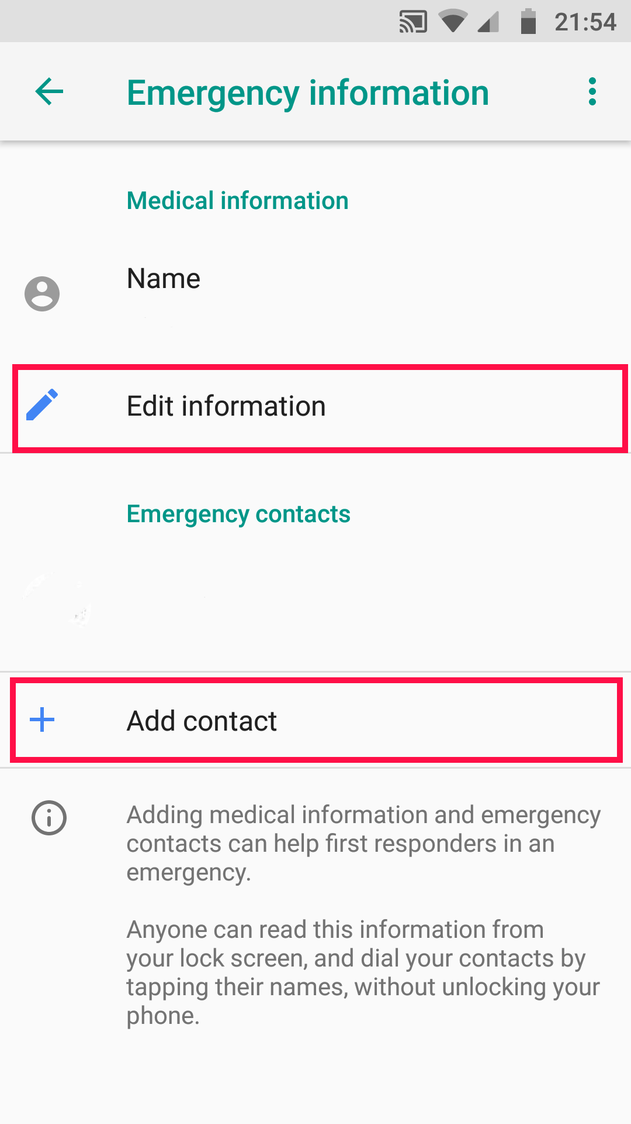
Adding the Plan to an Android Phone
Open phone settings.
Tap About Phone.
Tap Emergency information.
Enter information under Medical Information and Emergency Contacts.
Turn on Show when device is locked.
AndyHat

Slide 31
Critical Medical Information
For those who do not carry anything with them, consider a wrist band or shoe tag with critical medical information.

Slide 32
Resources
I used a Letter of Intent form from www.howtosecurethefuture.com
We also have two other forms at https://www.theadmh.org/new-external-resources under Resources. One is more complicated than the other but both are very thorough.
Google "Medical Emergency Plan templates"
Notes:
Think especially about siblings who may be left to care for your loved one but do not know all of the details of what you have learned over years – medical stuff, SSI details, waivers, providers. Is it any wonder that they would be suddenly overwhelmed??

Slide 33


Georgia Gives 2024
We need your help to serve more individuals with intellectual and developmental disabilities with compassionate, person-centered medical care.
https://www.gagives.org/organization/Admh

Slide 34
Resources/ Webinar Recordings
Thank you for attending our webinar series First Things First.
Please go to our website https://www.theadmh.org/events for the recording of each session in the series and more information.
Additional resources can be found under Resources.

Slide 35
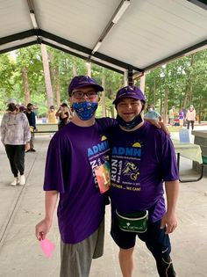
Your Feedback and Ideas
Please give us your feedback by completing the following poll questions.
You may contact us at info@theadmh.org for your additional questions!
Suggestions for additional topics are welcome!

Slide 36
Planning for Other Emergencies
What information or knowledge would someone need to have for different types of emergencies? What would you do if/……..?
Identify and Teach these Situations!
Basic Readiness
Medical
Weather
Fire
Plumbing

Slide 37
Basic Readiness
Keep phone charged
Bottled water
A first aid kit
Flashlight, batteries
Battery-powered lights
Personal medications
Cash or credit cards
https://www.theadmh.org/patientvideos

Slide 38
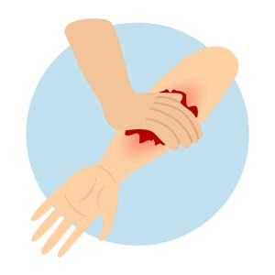
Medical Emergencies at Home
We need to teach exactly what to do in these situations, including when to call and not call 911!
Bleeding
Difficult Breathing
Burns
Heart Irregularities
Pain
Break or sprain
Vomiting excessively
When am I sick enough or hurt badly enough to call the doctor?
Tenet Health

Slide 39
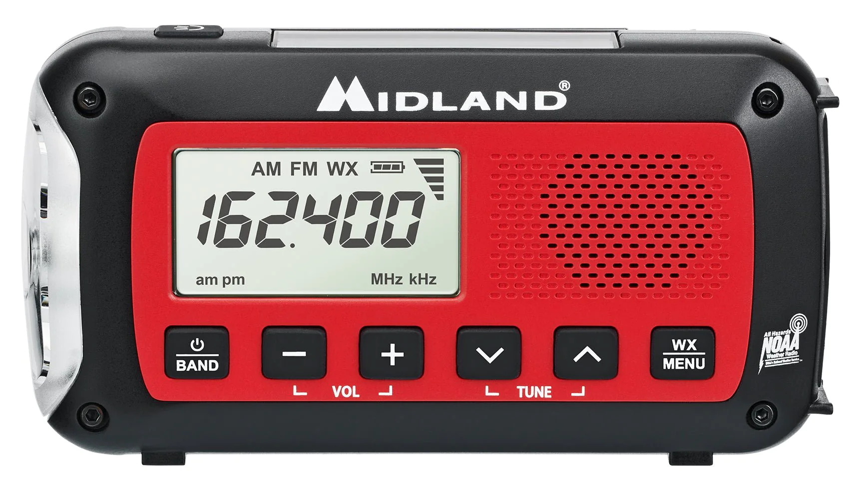
Weather Emergencies
Severe weather can be anticipated.
Know the safest place to go in your home or at work.
Have a source of information that will not be affected by the weather.
Listen to alerts.
Have a supply of food, water, & medication on hand.
Have a well-stocked first aid kit.
Midland Radio

Slide 40
An Advanced Emergency Kit
Non-Perishable Food Items
Toilet Paper
Multi-Tool with a Can Opener
Wrench or Pliers Kit (to turn off gas/water lines)
Extra Clothing
Blankets
Disinfectant Wipes
Extra Chargers
Important Documents (ex. deed/lease, passport, birth certificate, insurance policy, emergency contact information)
Extra Keys
Battery Powered NOAA Weather Radio
Whistle (in case you get trapped)

Slide 41
Fire Safety
Have an escape plan and practice it.
Can they get out independently? If not, who will help them?
Have a meeting place outside the home.
Know when to call 911.
Know when to stay in place.
Know how to use a fire blanket or extinguisher.
Know how to check smoke alarms and carbon monoxide detectors and replace batteries.
Notes:
Ground floor or upper level? Ladder? Routes out of the house.

Slide 42
Household Emergencies
Do they call someone or wait?
Do they know how to turn off the water to the house or to one bathroom?
Electrical – power is out.
Plumbing – sink won’t drain, water is flooding the bathroom, toilet won’t flush.
Broken glass – handle safely.
The refrigerator is not cold.
The dishwasher is not draining.
The clothes in the dryer are not getting dry.

Slide 43
Don’t Panic
You are teaching all the time just by living together and practicing these skills.
They probably learned some skills in school, but some scenarios at home may be different.
Some free life skills resources are available as PDFs on our website at www.dunamised.org . More are being posted so stay tuned. You can print them if you like. But practicing something usually stays with them the best.

